Slide 1
Genome Assembly and Long Reads
Chad Tomlinson
BGA Group
McDonnell Genome Institute
4444 Forest Park Ave.
St. Louis, MO 63108
Notes:
I'm Chad Tomlinson. I am a member of the BGA group.
I have been at the McDonnell Genome Institute for a little over 20 years now.
I have worked in the areas of genome finishing and improvement,
genome assembly, and on many other types of bioinformatics analysis such as variant detection and RNAseq analysis.

Slide 2
Outline
Definition of long read sequencing and its applications.
Brief introduction to the two main long read sequencing technologies.
Explanation of genome assembly and how long reads improve assemblies.
Examples of commonly used long read genome assembly algorithms.
Overview of the pb-assembly (Falcon-Unzip) assembly algorithm.
Brief walkthrough of the steps involved in running pb-assembly.

Slide 3
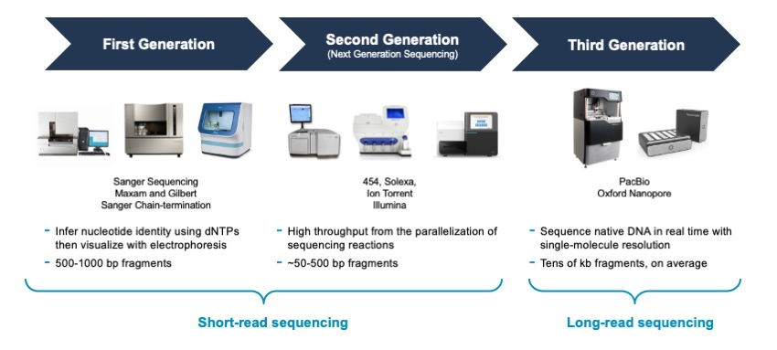
Evolution of DNA Sequencing
Notes:
This slide illustrates the progression of DNA sequencing technologies from Sanger sequencing to short-read next generation sequencing methods (Illumina/454) to the long read sequencing methods also
called third generation sequencing. Long read sequencing typically references reads that are >=10Kb in length, although when these technologies first came out, the read lengths were not that long.

Slide 4
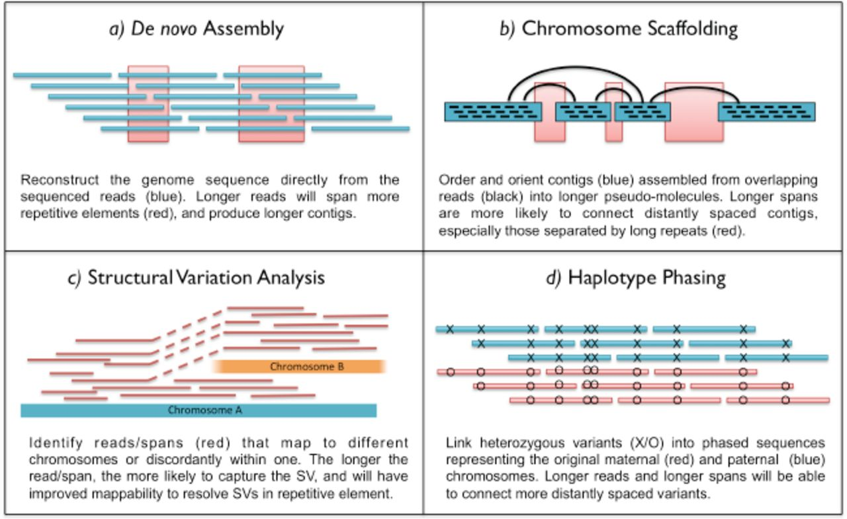
Long Read Analysis Applications
Notes:
Here we can see some of the analysis applications that long read sequencing is used for. Long reads offer an advantage over short reads for most of these applications.

Slide 5
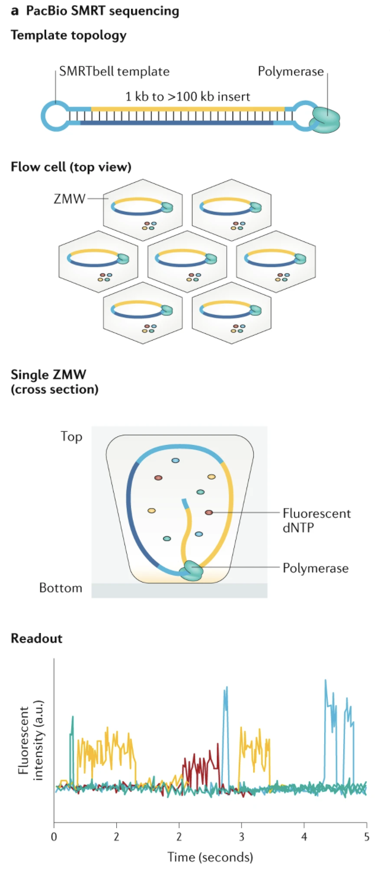
Pacific Biosciences SMRT Sequencing
Uses a topologically circular DNA molecule template called a SMRTbell, comprised of a double-stranded DNA insert with single-stranded hairpin adapters on either end.
DNA insert can range from 1 to more than 100 Kb in length.
Once the SMRTbell has been assembled, it is bound by a DNA polymerase and loaded onto a SMRT cell
A SMRT cell is a chip that contains 8 million sequencing units called ZMWs – zero mode waveguides.
ZMW is a nanophotonic confinement structure consisting of a circular hole ~70 nm in diameter and ~100 nm in depth. This provides the smallest available volume for light detection.
A single SMRTbell diffuses into each ZMW.
Notes:
One of the two types of long read sequencing technologies was developed by Pacific Biosciences. SMRT stands for Single Molecule Real Time Sequencing.

Slide 6
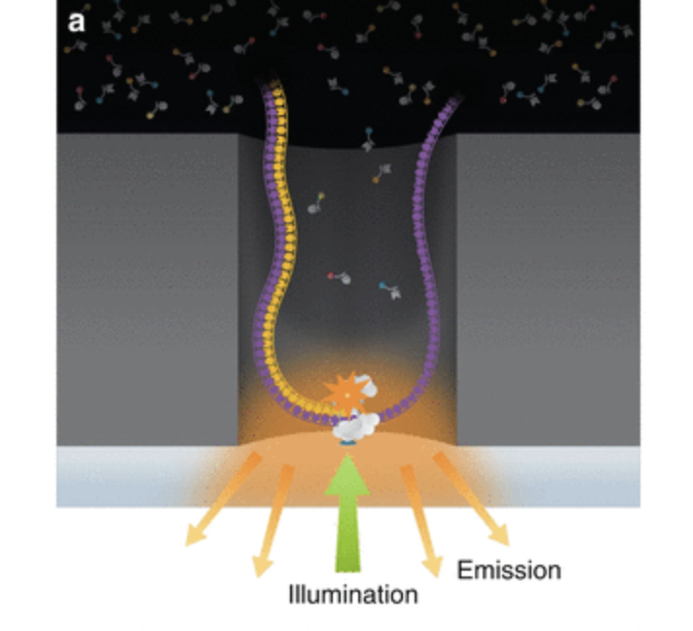
Pacific Biosciences SMRT Sequencing
Within each ZMW, a single polymerase is immobilized at the bottom. The polymerase can bind to either hairpin of the SMRTbell and start the replication process.
Four flourescent-labeled nucleotide bases, which generate distinct emission spectrums, are added to the SMRT cell. As each base is held by the polymerase, a light pulse is produced that identifies the base.
The replication processes in all ZMWs of a SMRT cell are recorded by a “movie” of light pulses, and the pulses corresponding to each ZMW can be interpreted to be a sequence of bases called a continuous long read, CLR.

Slide 7
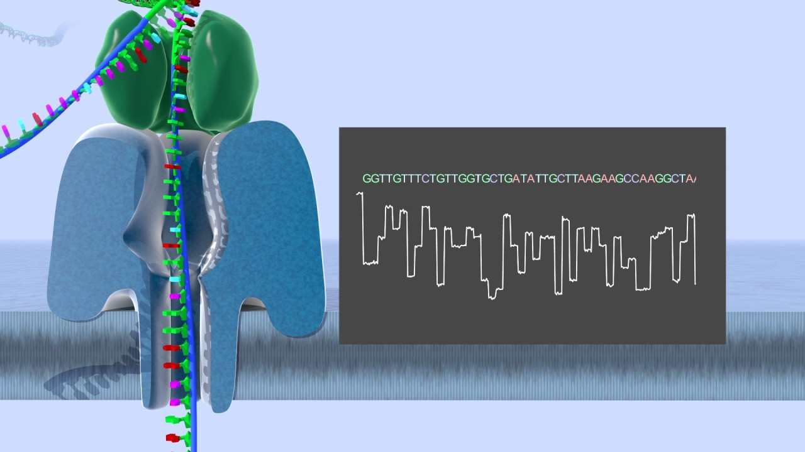
Oxford Nanopore Sequencing
Uses linear DNA molecules instead of circular ones. These molecules are usually between one and several hundred Kb in length, but can be up to several megabases long.
Sequencing begins by attaching a double-stranded DNA molecule to a sequencing adapter that is pre-loaded with a motor protein.
The DNA mixture is loaded onto a flow cell that contains hundreds to thousands of nanopores embedded in a synthetic membrane.
The motor protein unwinds the double-stranded DNA and in conjunction with an electric current, drives the negatively charged DNA through the pore at a controlled rate.
As the DNA passes through the pore, it causes specific disruptions to the current. These disruptions are analyzed in real time to determine the sequence of the bases in the DNA strand.
Reads >1Mb in length have been generated with the longest reported reads close to 2.3Mb in length.

Slide 8
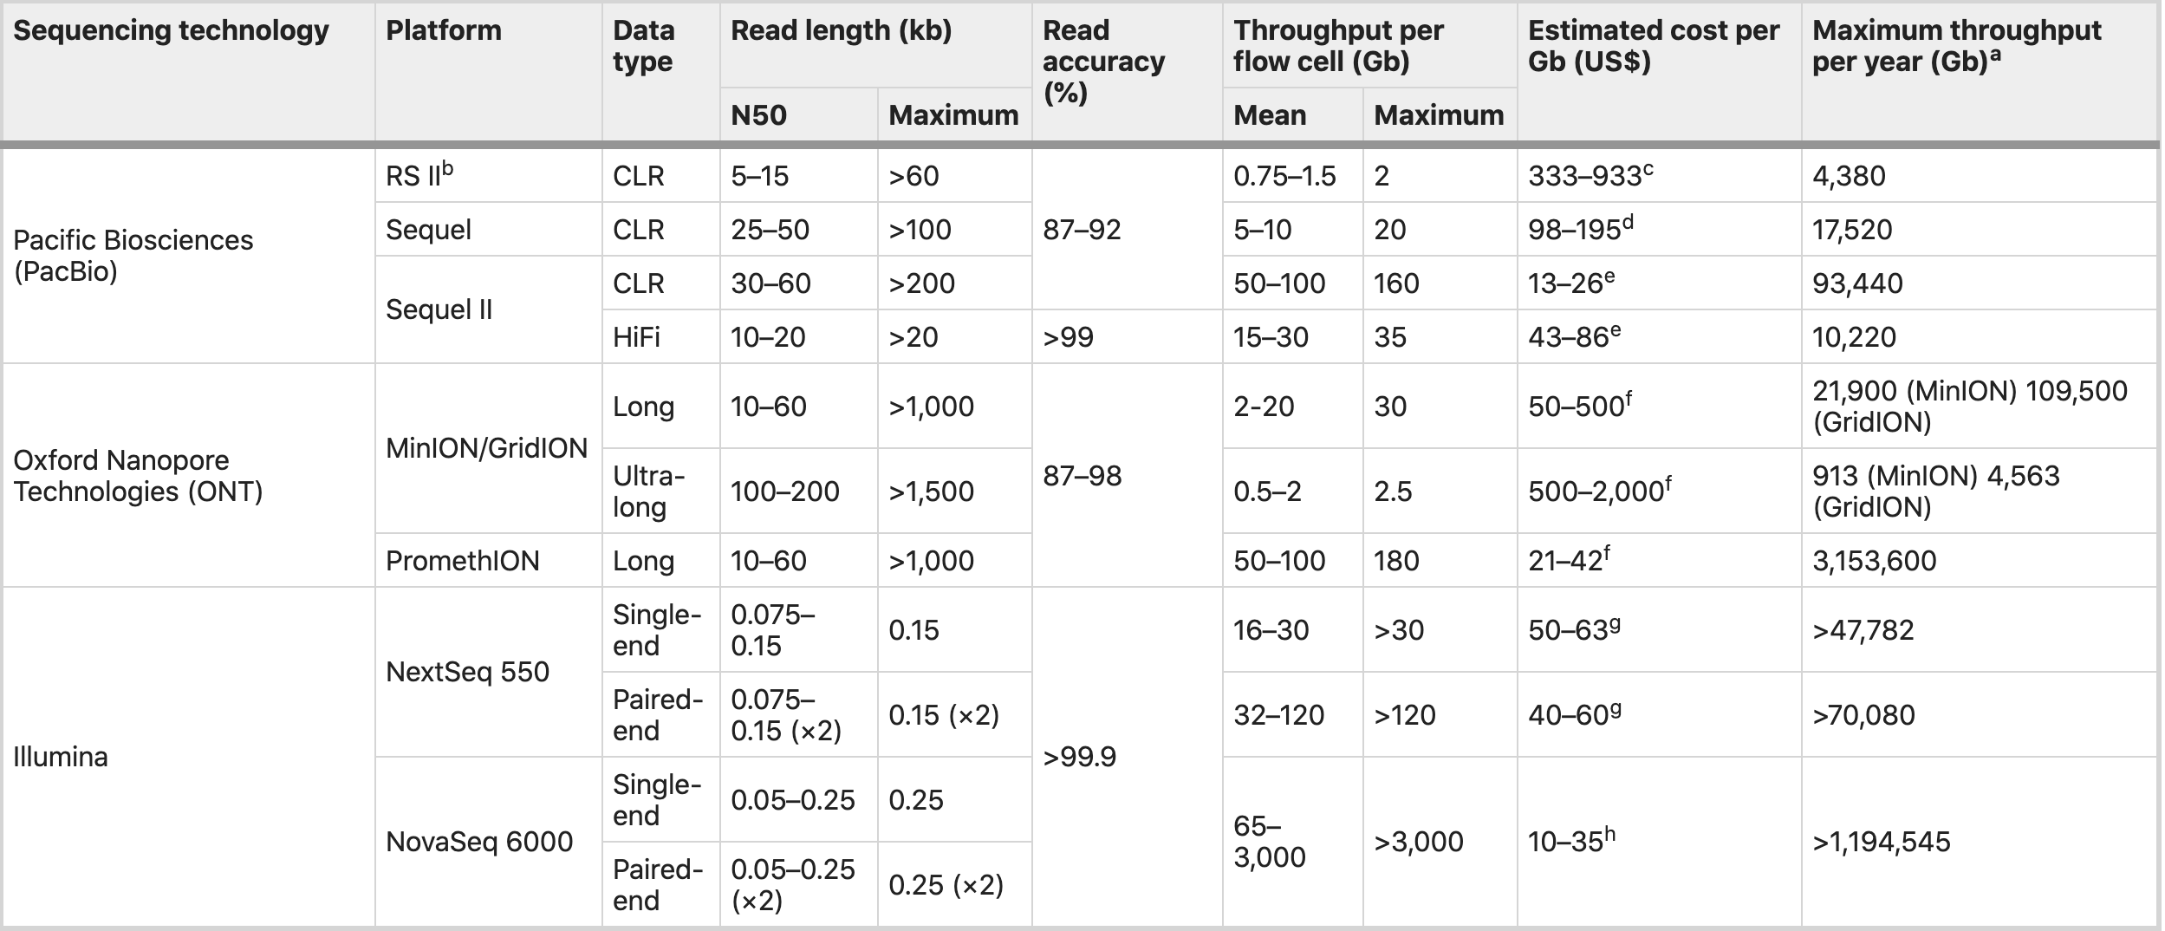
Long Read Sequencing Overview
Notes:
Comparison of the accuracy, throughput per flowcell, and cost per Gigabase for several sequencing technologies.
PacBio CLR data has a read accuracy of between ~87% to ~92% and errors are randomly distributed throughout the read.
Oxford Nanopore reads typically have a mean accuracy between 87% to 98%, but a small portion of reads can have accuracy as low as 69%.
Error is not as randomly distributed as with Pacbio data. You typically see a larger concentration of errors in homopolymer regions.

Slide 9
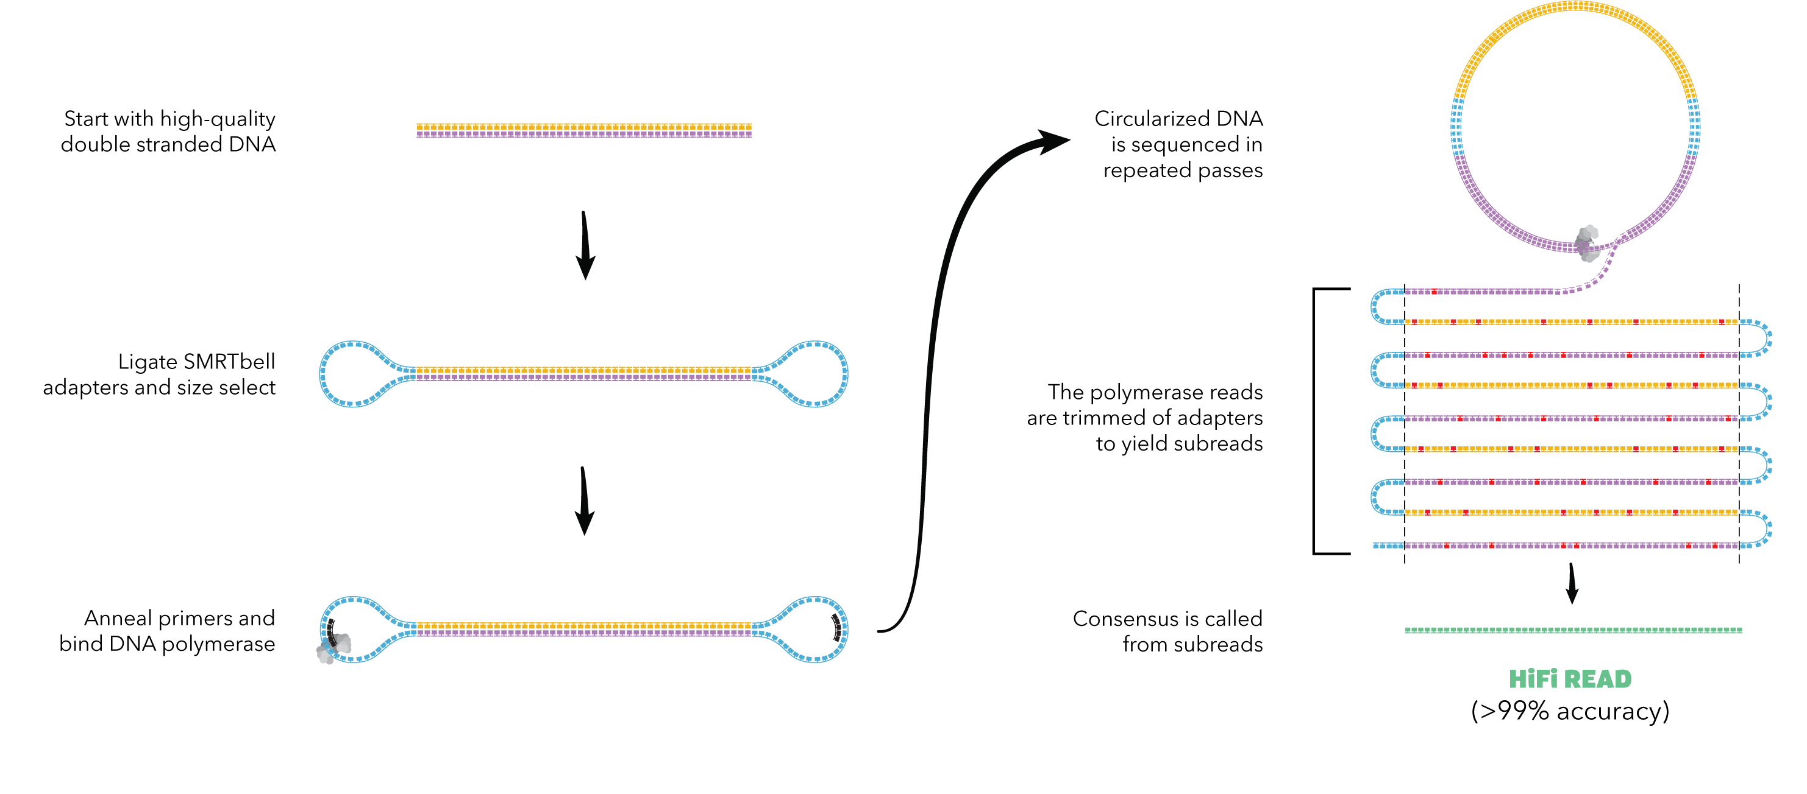
PacBio HiFi (CCS) Sequencing
Pacbio CLR subread accuracy typically ranges between ~85% to 92% with error distributed randomly.
Only ~85% of homopolymers at least five bases long are called accurately in CLR reads.
HiFi (CCS) sequencing involves multiple passes around the SMRTbell.
Since error is distributed randomly, you can call a more accurate HiFi (CCS) read consensus with 3 to 4 passes around the insert.
HiFi (CCS) reads have a median accuracy of greater than 99.9%, with over 99.5% of homopolymers at least 5 bp long accurately called.
More than 50% of the regions previously inaccessible with Illumina short-read sequencing data in GRCh37 (human reference) are now accessible with HiFi reads.
Notes:
Analysis of CLR data often requires advanced algorithms that take the error rate into account or computationally intensive processes in order to error correct the reads.

Slide 10
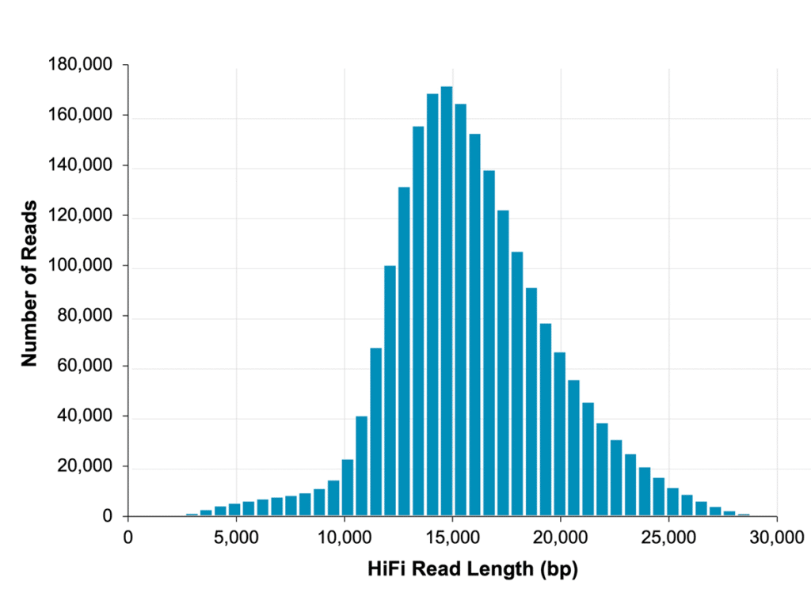
PacBio HiFi Read Length Distribution
Notes:
Chemistry updates from Pacific Biosciences continue to improve the read lengths of HiFi reads.
Pacbio also continues to improve the efficiency of the processing required to output HiFi reads from a CLR run.
Evaluation of read length distribution graphs is one method to assess a set of sequencing data.

Slide 11
Goals of Genome Assembly
Determine the complete genome sequence of an organism.
As few gaps in the sequence as possible
As accurate of a sequence as possible
Assemble and organize the sequence.
Into contigs
Into scaffolds
Into chromosomes
Annotate the protein-coding gene sequence. (and other genetically important functional features)

Slide 12
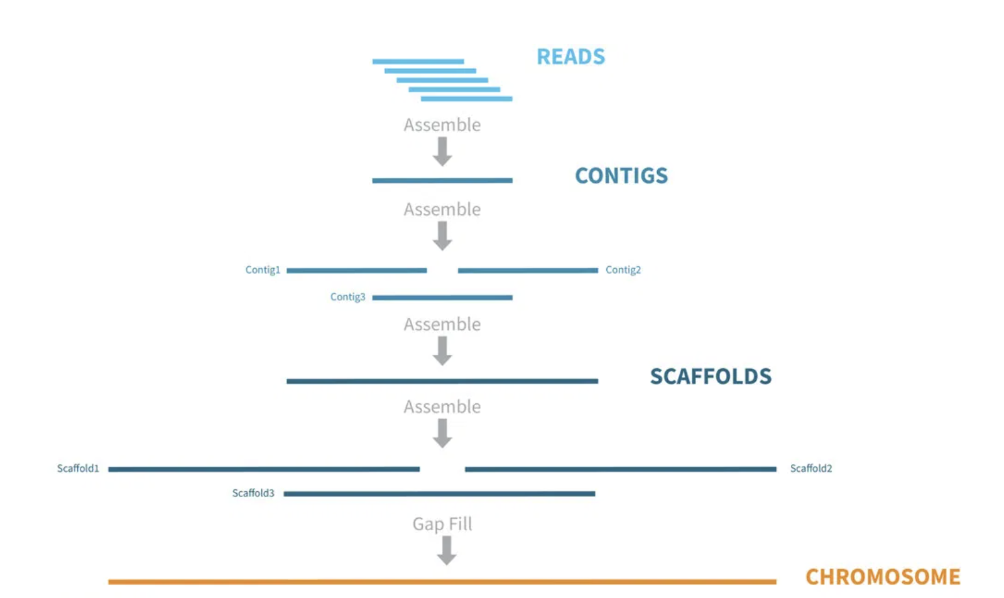
De Novo Genome Assembly Process and Outputs
Algorithms are used to find accurate overlaps between reads. The consensus of a set of overlapping read sequences is called a contig.
Contigs are segments of the genome that have gaps in between. In most instances, we do not know how the contigs are to be ordered and oriented in respect to one another.
We can use additional methods to order and orient contigs, fill in gap regions, and chain contigs together into larger sequences called scaffolds.
Scaffolding can be an additional step performed by the assembly algorithm, but it usually involves a separate process using BioNano, Hi-C, Oxford Nanopore data. or other data types.
Additional methods can be used to organize scaffolds into more complete chromosomal level assemblies.
Contigs and scaffolds are typically available in FASTA and/or FASTQ formats.
Notes:
Assemblers use different methods to find accurate overlaps between reads and assemble them into contigs.

Slide 13
Two main assembly methods
Overlap Layout Consensus Assemblers – Mainly used for long reads
Construct overlap graph directly from reads, eliminating redundant reads; trace path for assembly.
Examples: pb-assembly (Falcon), Canu, Hifiasm
de Bruijn graph based Assemblers – Mainly used for short reads
Construct k-mer graph from the reads; original reads are discarded.
Trace a path through the graph to arrive at the assembly.
Examples: SOAPdenovo2, ABySS

Slide 14
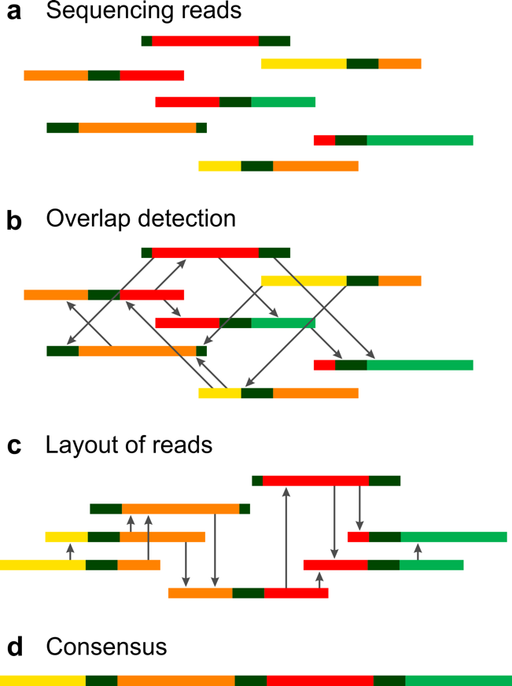
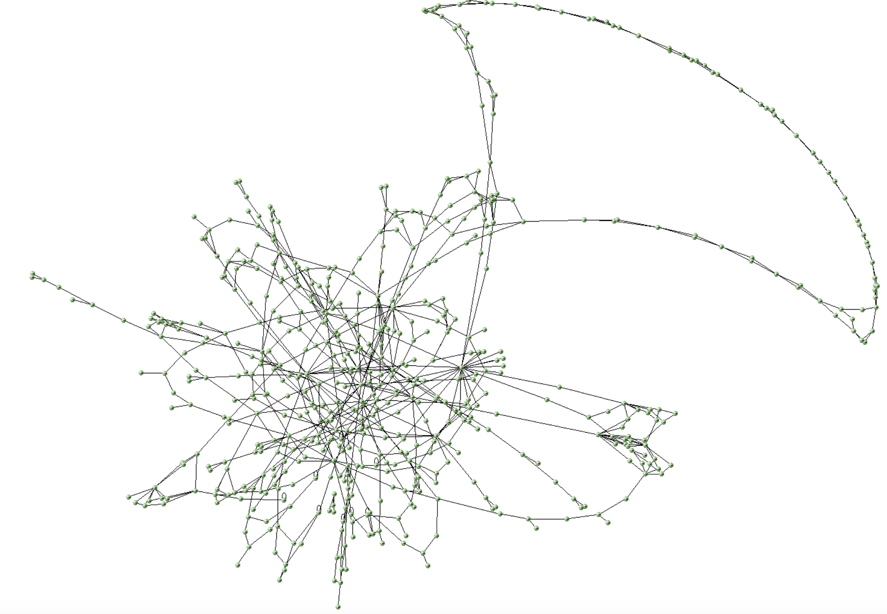
Overlap Layout Consensus Graph
All read vs. all read alignment and identify all possible overlaps between reads.
The overlap relationship between reads is captured in a large assembly graph.
The graph is refined to correct errors and simplify.
Find the best path through the graph and traverse each node in the graph once.
Output the consensus of the path as the assembly.
Notes:
Most of the long read assembler algorithms are based upon the overlap layout consensus graph method.

Slide 15
Challenges to Genome Assembly
Repeats
Repetitive regions can make it more difficult to determine read placement leading to misassemblies, which are errors in the construction of the assembly.
Long reads can help this by traversing the longest repeats in the genome.
Sequencing Errors or Assembly Errors
Base errors in sequencing reads or consensus errors introduced by assemblers can confound the assembly process.
Heterozygosity: Presence of different alleles at the same loci in homologous chromosomes
Alleles from the same locus are more likely to be mistaken as sequences from different loci.
The assembler may incorporate two different contigs that actually represent the same regions of the genome.
This might be desirable if you are seeking haplotype separated diploid or polyploid assemblies.
Contamination
Contamination in the sequencing data can lead to contigs of contamination in your final assembly.
Adapter contamination of the read data can impact assembly results.
Notes:
Contamination can also result in an insufficient amount of coverage of the target genome resulting in an incomplete assembly with more gaps.

Slide 16
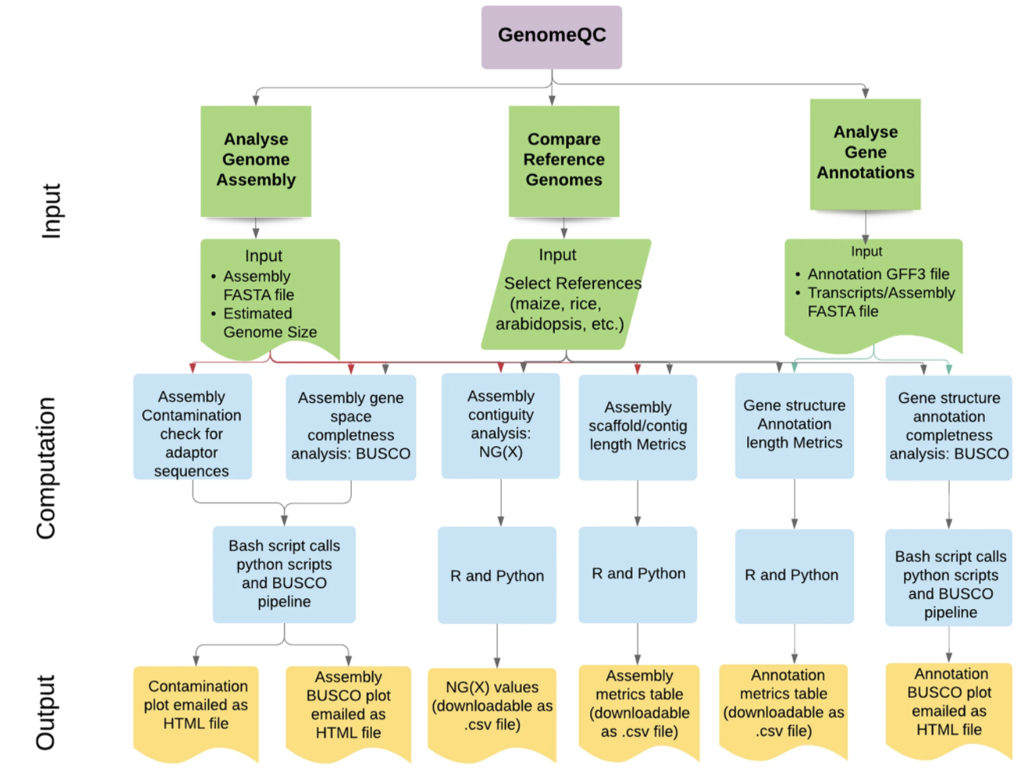
Methods to QC Genome Assemblies
Assembly scaffold/contig length metrics
-N50 length, avg. length, # contigs/scaffolds
Compare assembly to Reference Genome
-Identify misassemblies
-Identify real SNPs and SVs (indels, translocations, duplications)
Evaluate against an optical map: Ordered, genome wide high resolution restriction map
-Identify misassemblies
-Scaffold contig assemblies
Busco Analysis: Evaluation of the assembly against a set of single-copy orthologs present in 90% of species of a particular group.
-What percentage of core genes does your assembly contain?
-Measure of assembly completeness.
Notes:
Comparing an assembly to a Reference Genome or an optical map can help pinpoint regions in an assembly that require additional manual review and possible correction:
This can be pulling apart collapsed repeats and fixing other types of misassemblies.
BUSCO is also called ”core” gene evaluation. There are different BUSCO sets depending upon the type of organism you are evaluating: Vertebrata, Bacterial, etc.

Slide 17
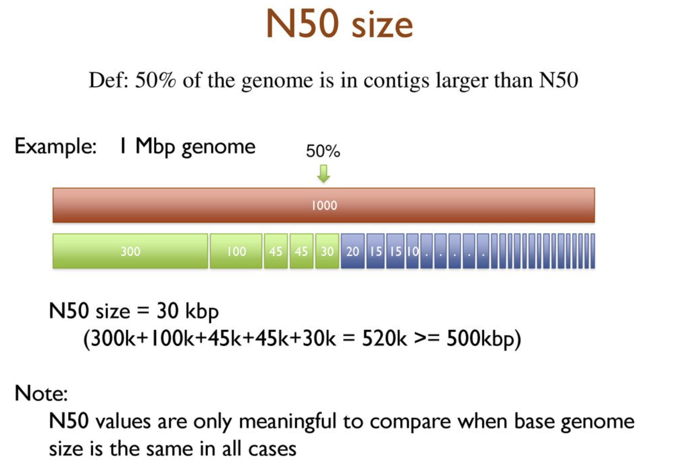
N50 Contig/Scaffold Length
Notes:
Line up all contigs from longest to shortest. Start summing contigs in this order until you add in the contig that will bring the sum total to >=50% of the total genome size. That is the N50 contig. It is a measure of contiguity used
when describing and comparing genome assemblies. It is not a measure of assembly accuracy and does not take into account potentially assembly problems, like misassemblies.

Slide 18
Assemblers for PacBio Data
De novo Assemblers
Pb-assembly (Falcon/Falcon-Unzip)
Canu/HiCanu
Trio Based Assemblers: Use short reads from parents to partition child reads by maternal/paternal haplotypes prior to assembly.
TrioCanu
HiFiasm
Reference Assisted Assemblers: Using the reference to assist in building the reads into contigs/scaffolds. This can bias assembly results towards the reference used.
RefKA
Hybrid Assemblers : Use short and long reads. More effective for assembly of complex genomes (e.g. Plants)
Masurca
PBcR

Slide 19
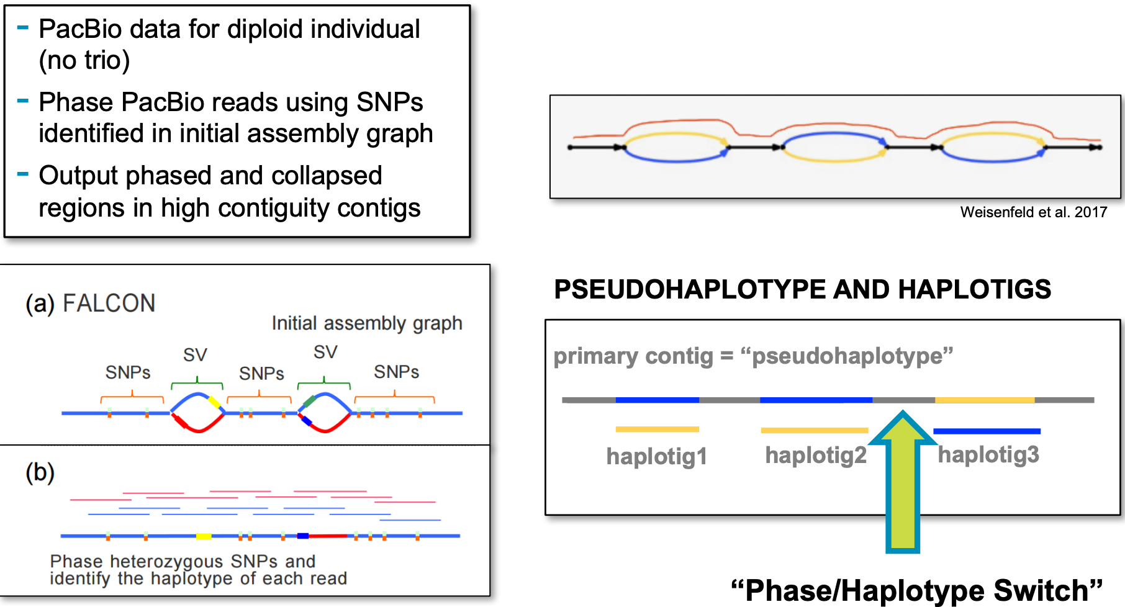
PB Assembly (Falcon/Falcon-Unzip) of HiFi Data
Falcon Assembly:
-Input is PacBio HiFi data in FASTA format.
-Output is haplotype-fused assembly in FASTA format and set of associated contigs (SVs from primary contig assembly).
Falcon-Unzip:
-Align reads to contigs and phases the reads using heterozygous SNPs.
-SNPs are used to separate the haplotypes into partially phased primary contigs and fully phased haplotigs.
-There are switch errors in the output between maternal and paternal haplotypes.
-Output is a FASTA file of primary contigs and a FASTA file of haplotigs.

Slide 20
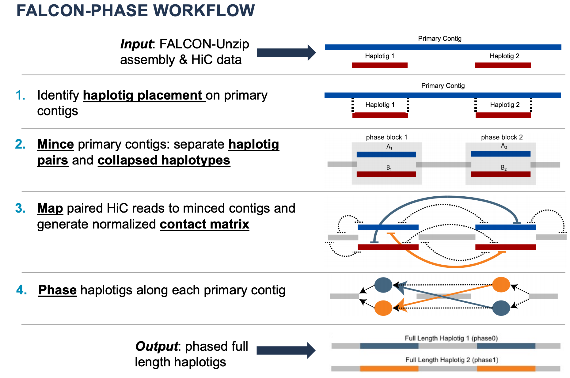
Falcon-Phase
Notes:
Falcon-Phase is a method for using ultra-long range Hi-C chromatin interaction data to create high quality, phased type assemblies from the outputs of Falcon-Unzip.
The output is phased, full length haplotigs. There are still switch errors between maternal and paternal haplotypes, but the switch errors are reduced compared to the output of Falcon-Unzip

Slide 21
Acknowledgements
Long-read human genome sequencing and its applications
Logsdon, G.A., Vollger, M.R. & Eichler, E.E. Long-read human genome sequencing and its applications. Nat Rev Genet 21, 597–614 (2020). https://doi.org/10.1038/s41576-020-0236-x
Accurate circular consensus long-read sequencing improves variant detection and assembly of a human genome
Wenger, A.M., Peluso, P., Rowell, W.J. et al. Accurate circular consensus long-read sequencing improves variant detection and assembly of a human genome. Nat Biotechnol 37, 1155–1162 (2019). https://doi.org/10.1038/s41587-019-0217-9
Long-read sequencing in deciphering human genetics to a greater depth
Midha, M.K., Wu, M. & Chiu, KP. Long-read sequencing in deciphering human genetics to a greater depth. Hum Genet 138, 1201–1215 (2019). https://doi.org/10.1007/s00439-019-02064-y
Introduction to Genome Assembly
Bioinformatics Workbook (Online)
Andrew Severin - Author
https://bioinformaticsworkbook.org/dataAnalysis/GenomeAssembly/Intro_GenomeAssembly.html
Phased Diploid Genome Assembly with Single Molecule Real-Time Sequencing
Chin CS, Peluso P, Sedlazeck FJ, et al. Phased diploid genome assembly with single-molecule real-time sequencing. Nat Methods. 2016;13(12):1050-1054. doi:10.1038/nmeth.4035
Extended haplotype phasing of de novo genome assemblies with FALCON-Phase
Zev N. Kronenberg, Arang Rhie, Sergey Koren, Gregory T. Concepcion, Paul Peluso, Katherine M. Munson, Stefan Hiendleder, Olivier Fedrigo, Erich D. Jarvis, Adam M. Phillippy, Evan E. Eichler, John L. Williams, Tim P.L. Smith, Richard J. Hall, Shawn T. Sullivan, Sarah B. Kingan
bioRxiv 327064; doi: https://doi.org/10.1101/327064
GenomeQC: a quality assessment tool for genome assemblies and gene structure annotations
Manchanda, N., Portwood, J.L., Woodhouse, M.R. et al. GenomeQC: a quality assessment tool for genome assemblies and gene structure annotations. BMC Genomics 21, 193 (2020). https://doi.org/10.1186/s12864-020-6568-2

